Slide 1






CSE 4408: SYSTEM ANALYSIS AND DESIGN LAB
Palestine Supporter Group
Shuaibu mustapha musa 210041270
Ahmed M. S. Albreem 210041258

Slide 2

What is the Project ?
The project manages airport operations, including visitor management, ticketing.
It utilizes functions to
  guide employees toward their tasks
  scheduling them in a system table for efficient management.

Slide 3
Key Features :
Flight Scheduling
Mobile Accessibility
User-friendly Interface
Intuitive and user-friendly interface designed for airport staff and passengers

Slide 4

Technical Feasibility
Software and Hardware Requirements :
the headwear android devices for testing with screen sizes and operating system for computing, software of MIT codes, and firebase .
Evaluation of Technical Expertise :
The hardware includes Android devices
The software comprises any MIT coded systems Firebase for data storage to make sure the real-time data working better .
Assesses complexity and risks :
  user authentication
  data synchronization
  user interfaces

Slide 5


Economic Feasibility
Tangible Costs :
One-time Costs:
Software and Licenses: ৳50,000
Hardware: ৳50,000
Custom Development : ৳500,000
Training: ৳150,000
Recurring Costs:
Annual Maintenance: ৳80,000
IT Infrastructure: ৳120,000

Slide 6
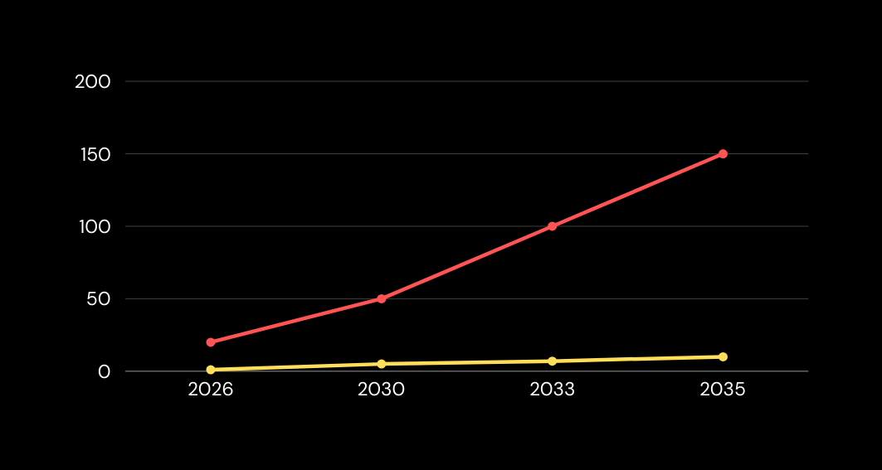

SALES RATE FOR THE 10 NEXT YEARS
Cost-Benefit Analysis :
Return on Investment (ROI) Analysis :
ROI over 1 year: aiming for at least 5-10% ROI.
ROI over 5 years: cumulative ROI of at least 25-50%.
ROI over 10 years: aiming for a significant ROI of 50-100% or more.

Slide 7

Economic Tangible Benefits :
  Improved Safety and Security: Proper management ensures compliance with safety and security regulations
  Environmental Sustainability: Implementing eco-friendly practices .
Economic Intangible Benefits:
  Enhanced Customer Experience: Efficient operations, shorter waiting times, improved facilities
  Reputation and Brand Image: Well-managed airports are perceived as reliable, safe, and customer-friendly.

Slide 8

Operational Feasibility :
Improvements Expected :
real-time data access, enhanced decision-making, improved customer experience .
Capability to Deliver Required Functionality :
Adequate throughput, real-time data processing, seamless user experience, and accessibility for staff and passengers.

Slide 9

THANK YOU

